Slide 1
State of Housing in Ohio
August 2022

Slide 3
Rent is Rapidly Rising

Slide 4
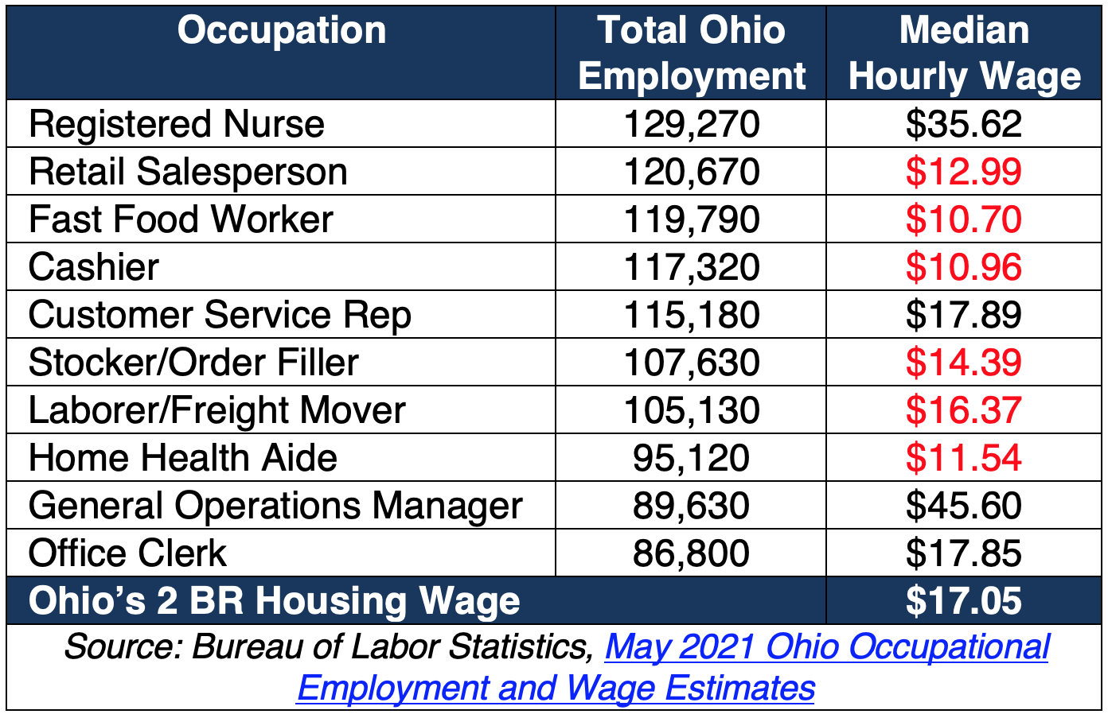
Can Workers Pay Rent?

Slide 5
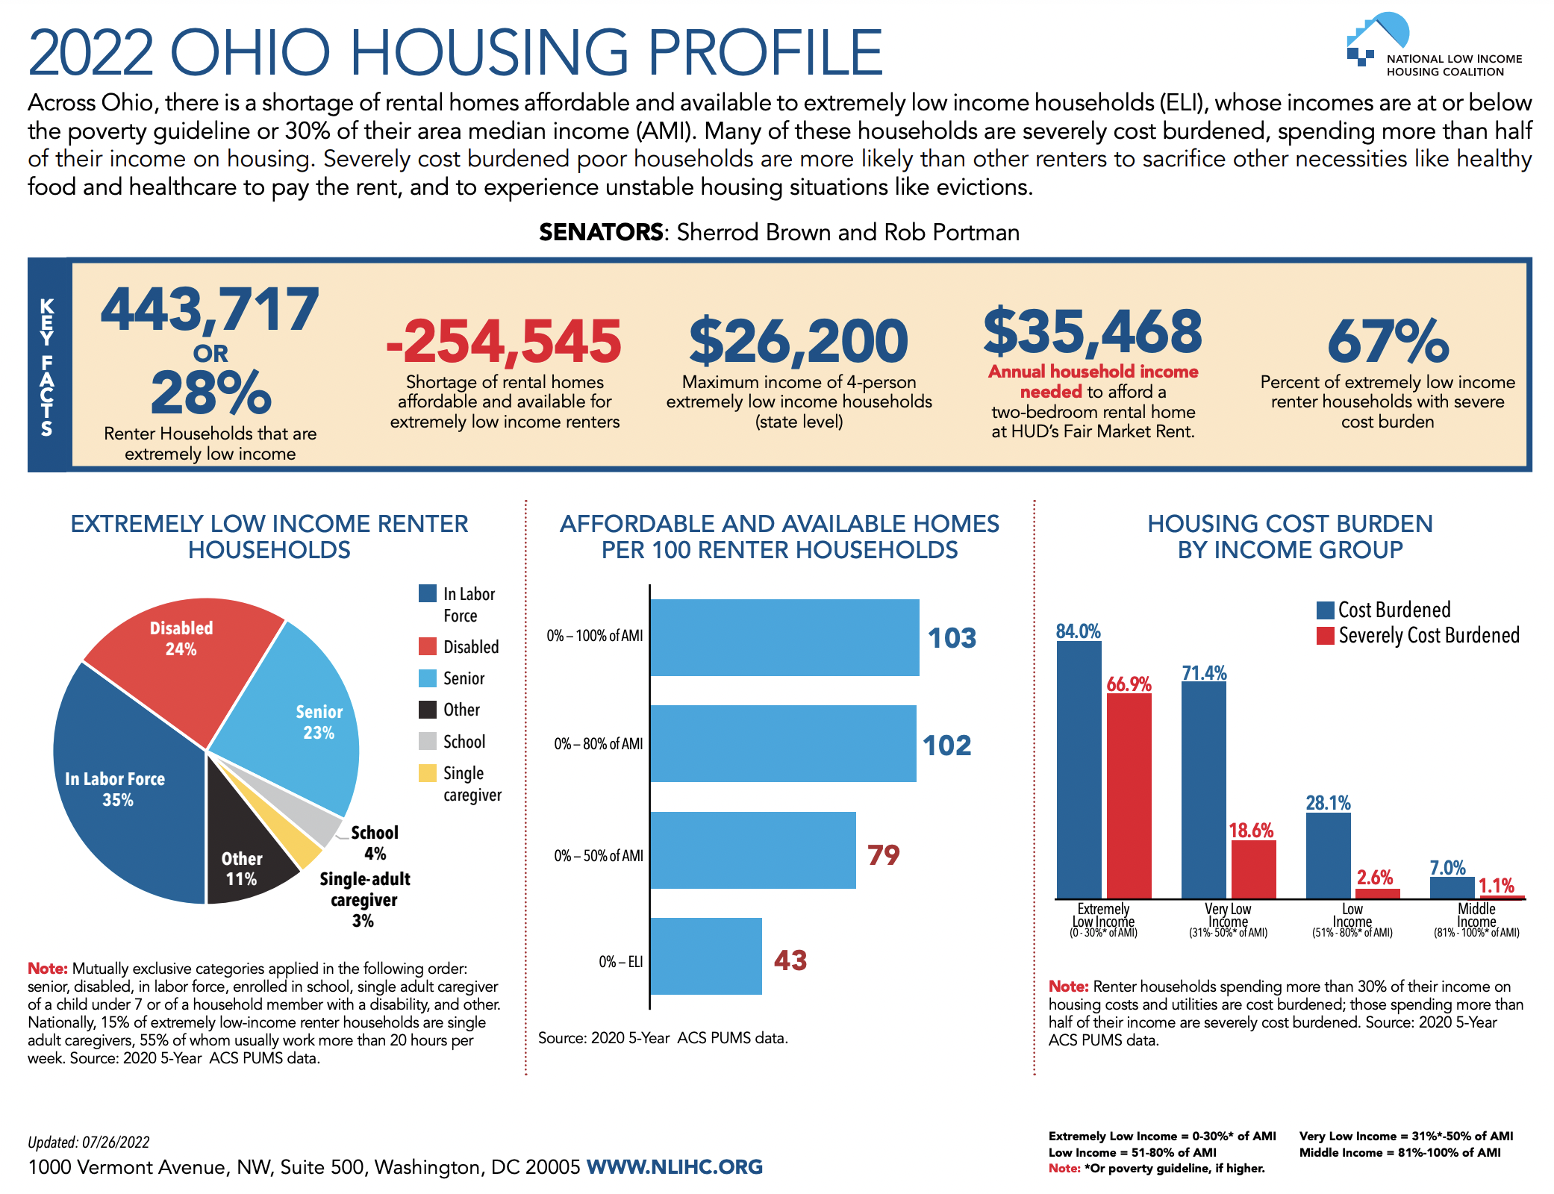

Slide 7
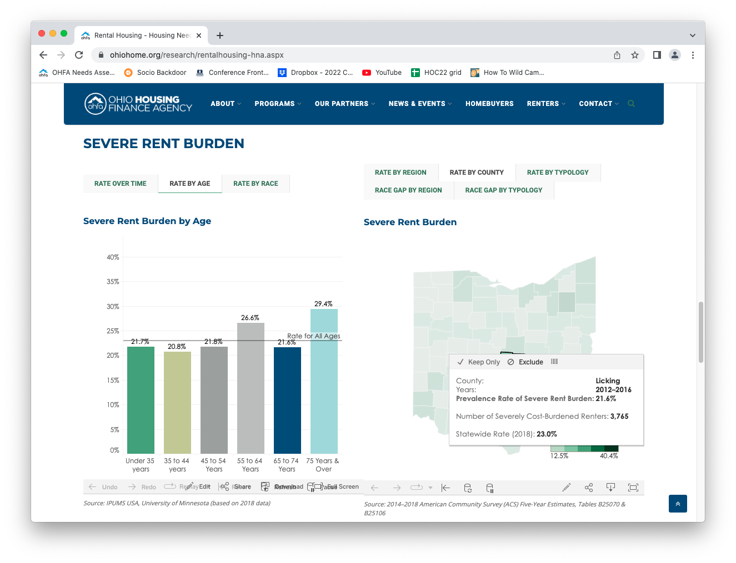
OHFA Housing Needs Assessment
https://ohiohome.org/research/housingneeds.aspx

Slide 8
Solution? Invest in Affordable Housing

Slide 9
Questions?
Amy Riegel
Executive Director
amyriegel@cohhio.org

